Slide 1













PLAYING SCREEN ARCHITECTURE = TO BE CAREFULLY FOLLOWED AND STRICTLY RESPECTED PLEASE
Score
+175
Hits
47
Coins
85
Lives
5
4 KEY INDICATORS
(Score / hits / coins / lives)
PROGRESS BAR
(the arrow moves toward the trophies on the right, proportionate to the number of stars collected)
Watch
3 seconds
Freeze 2 icons
BOARD ZONE
With 9 icons
4 MONETIZATION BUTTONS
(the 4 texts should be transformed and replaced by self-explanatory icons)
Cancel board move
Reshuffle the
board or challenge
TIMER
(plain orange is decreasing towards left when seconds remaining decrease)
Challenge 4/10
MAIN MENU BUTTON
Designed as a baker mascot
(main menu should be written on hat)
Cake House
=
customization
button
1 CUSTOMIZATION BUTTON designed as a Cake-House
(will lead to a menu where you can customize the look of your game by paying chocolate coins)
CHALLENGE & COMMUNICATION ZONE
With challenge numbering and various messages

Slide 2

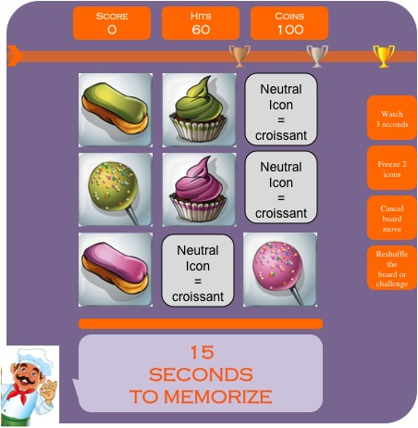
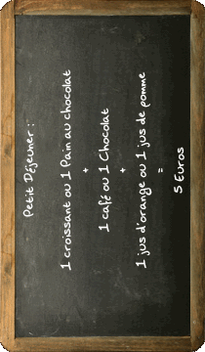
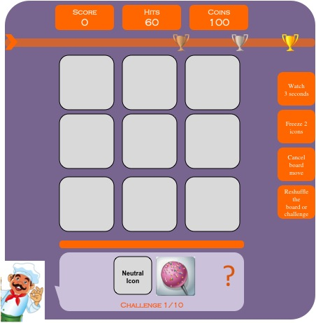
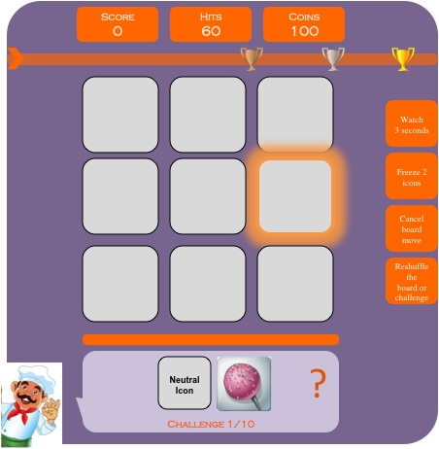
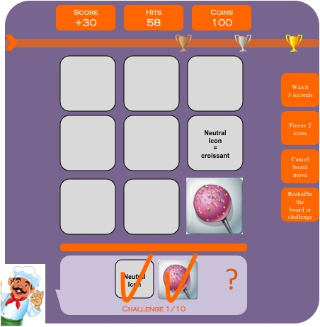
VERY FIRST TIME A PLAYER LOG INTO THE GAME = LEVEL 1 WITH TUTORIAL
1.1/ The logo appears while the game is loading
1.2/ The title of the game “POPCAKE LEGEND” appears with the baker + LEVEL 1 mention + objectives
(see page 11)
1.3/ The player DIRECTLY jump into Level 1 of the game. The orange TIMER line starts decreasing from 15 to 0.
Lives
5
cust
1.4/ The 9 icons are flipped back and the “Challenge 1/10” appears with a “?” in the CHALLENGE ZONE.
1.5/ As a TUTORIAL mode, 1 good icon of the challenge is flashing in orange to incentive the player to click on it. The player is not forced to click on the help-icon and can complete the challenge without help if he wants
1.6/ The score increases (REFER TO EXCEL, exponential scoring system) and the number of hits decreases until the player completes the challenge
Lives
5
Lives
5
Lives
5
cust
cust
cust

Slide 3
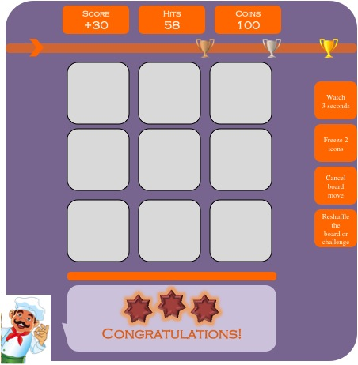
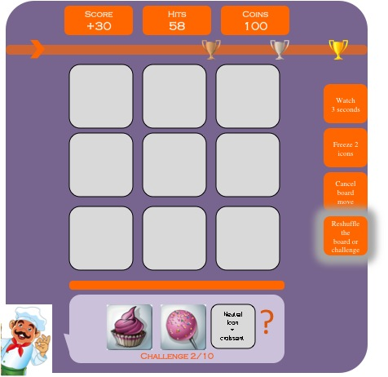
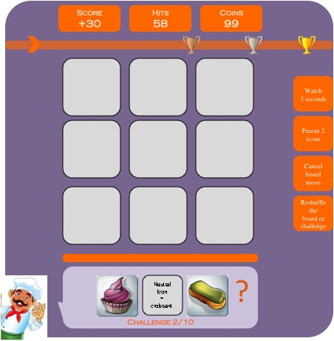
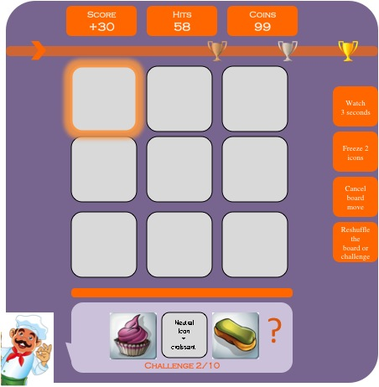
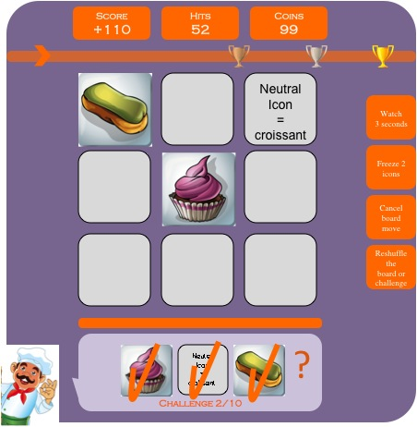
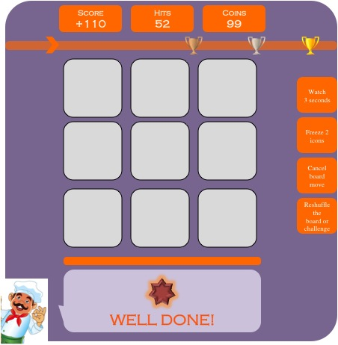
1.7/ When the challenge is completed, an encouraging message + chocolate stars (0-3 depending on nb of errors) appear in the COMMUNICATION ZONE. The arrow on the PROGRESS BAR moves accordingly
1.8/ The Challenge 2/10 appears in the CHALLENGE ZONE. As a TUTORIAL, the RESHUFFLE ICON down-right is highlighted/flashing to incentive the player to click on it.
1.9/ When the player click on “reshuffle” a new challenge is generated in the CHALLENGE ZONE and the COINS counter is decreased from 100 to 99 (i.e. costs 1)
Lives
5
Lives
5
Lives
5
NO
YES
cust
cust
cust
1.10/ As a TUTORIAL and HELP mode, 1 good icon of the challenge is highlighted/flashing in orange to incentive the player to click on it. NB: the player is not forced to click on the help-icon and can complete the challenge without help if he chooses to do so
1.11/ The score increases (REFER TO EXCEL, exponential scoring system) and the number of hits decreases until the player completes the challenge
1.12/ When the challenge is completed, an encouraging message + chocolate stars (0-3 depending on nb of errors) appear in the COMMUNICATION ZONE. The arrow on the PROGRESS BAR moves accordingly
Lives
5
Lives
5
Lives
5
cust
cust
cust

Slide 4
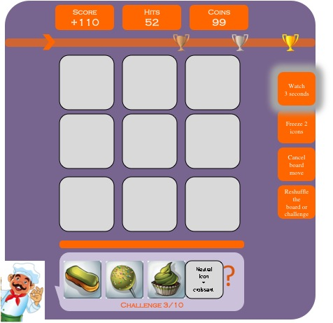
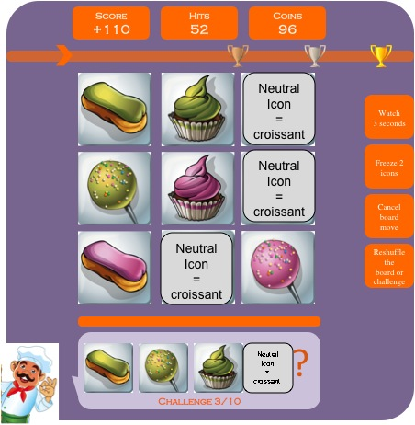
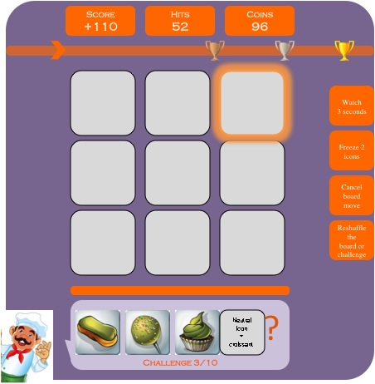
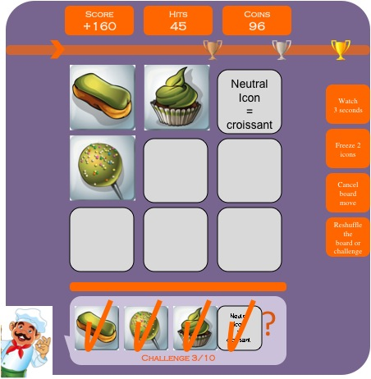
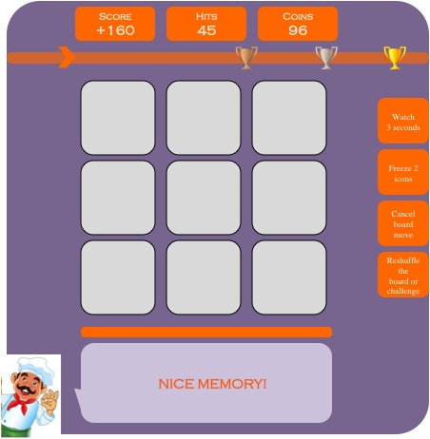
1.13/ The Challenge 3/10 appears in the CHALLENGE ZONE. As a TUTORIAL, the WATCH 3 SECONDS icon up-right is highlighted/flashing to incentive the player to click on it.
1.14/ When the player click on WATCH 3 SECONDS the 9 icons appear for 3 seconds and the COINS counter is decreased from 99 to 96 (i.e. costs 3)
1.15/ The board disappears and, as a TUTORIAL, 1 good icon of the challenge is highlighted/flashing to incentive the player to click on it. This is the LAST TIME an icon is shown for HELP in the game
Lives
5
Lives
5
Lives
5
NO
YES
cust
cust
cust
1.16/ The score increases (REFER TO EXCEL, exponential scoring system) and the number of hits decreases until the player completes the challenge
1.17/ When the challenge is completed, an encouraging message + chocolate stars (0-3 depending on nb of errors) appear in the COMMUNICATION ZONE. The arrow on the PROGRESS BAR moves accordingly
1.18/ Challenge 4/10 appears in the challenge zone.
HELP MODE is finished until end of Level.
The player should complete the remaining Challenges 4/5/6/7/8/9/10 on its own. Please refer to EXCEL spreadsheet for exact parameters for Challenges 4-10.
IMPORTANT NOTE:
THIS IS A TUTORIAL MODE WHERE THE PLAYER IS ONLY INCENTIVED TO CLICK ON THE FLASHING ICONS BUT NEVER FORCED TO DO SO. IF THE PLAYER DECIDES NOT TO CLICK THEN THE GAMEPLAY CONTINUES AS USUAL BUT THE BUTTON CONTINUES TO FLASH UNTIL CLICKED ON.
AS REAL MONEY WILL BE INVOLVED IN THE GAME, A CONFIRMATION BUTTON WITH PRICE MIGHT BE NEEDED FOR ALL 4 MONETIZATION BUTTONS. I WILL STUDY HOW TO INCORPORATE SMOOTHLY.
Lives
5
Lives
5
cust
cust

Slide 5
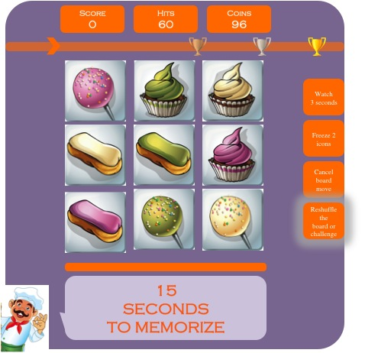
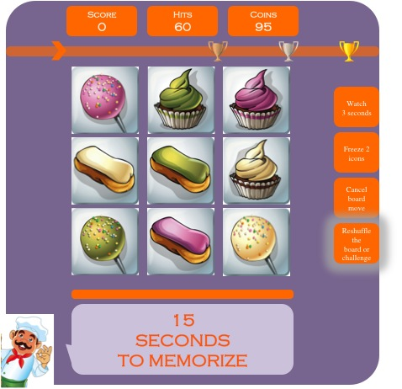

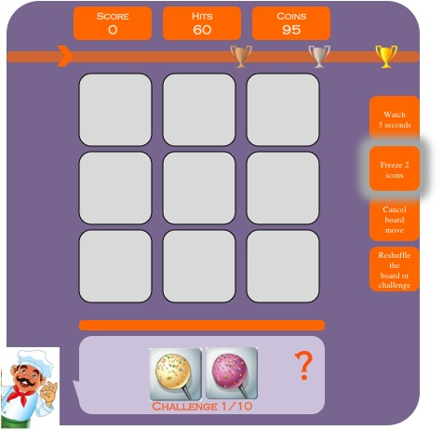
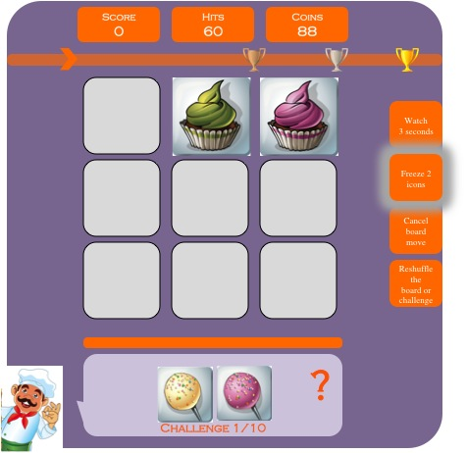
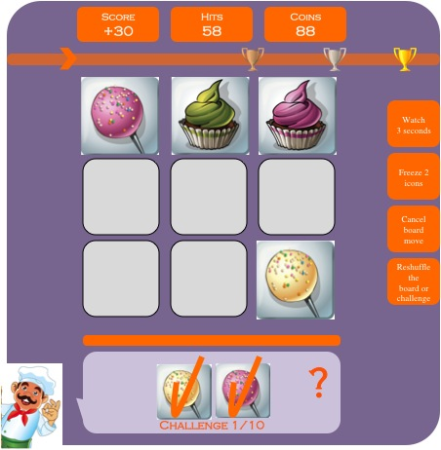
LEVEL 2 WITH TUTORIAL
2.1/ The title of the game “POPCAKE LEGEND” appears with the baker + LEVEL 2 mention + objectives (see page 11)
2.2/ Score/hits/progress bar are reset. Number of coins is the remaining from Level1. BOARD is generated and the TIMER line starts decreasing. As a TUTORIAL, the RESHUFFLE ICON is flashing/highlighted to incentive players to click on it.
2.3/ When the player click on “reshuffle” before timer ends, then a new BOARD is generated and the COINS are decreased from 96 to 95 (i.e. costs 1). The timer RESTARTS at 15 seconds
Lives
5
Lives
5
NO
YES
cust
cust
2.4/ The Challenge 1/10 appears in the CHALLENGE ZONE. As a TUTORIAL, the FREEZE 2 ICONS middle-right is flashing to incentive the player to click on it.
2.5/ When clicking on FREEZE 2 ICONS the COINS are decreased to 88 (i.e. cost 7). The player chooses 2 ICONS on the board that will stay VISIBLE DURING ALL LEVEL. NB: in the future, if a challenge is composed of visible icons, the player still need to click on them to validate such challenge (-1 hit)
2.6/ The score increases (REFER TO EXCEL, exponential scoring system) and the number of hits decreases until the player completes the challenge
Lives
5
Lives
5
Lives
5
NO
YES
cust
cust
cust

Slide 6
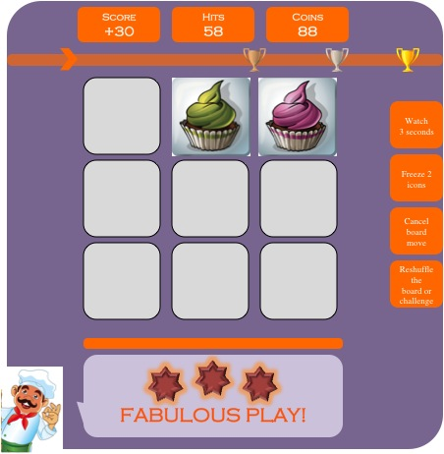
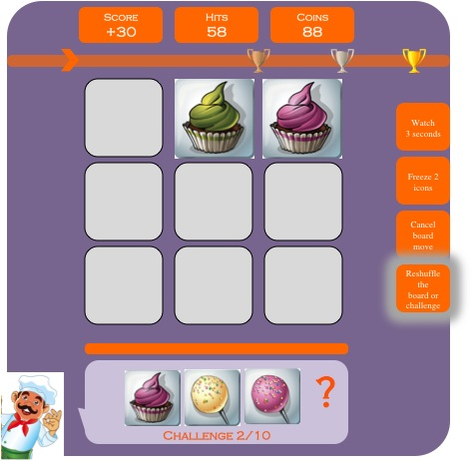
2.7/ When the challenge is completed, an encouraging message + chocolate stars (0-3 depending on nb of errors) appear in the COMMUNICATION ZONE. The arrow on the PROGRESS BAR moves accordingly
2.8/ The Challenge 2/10 appears in the CHALLENGE ZONE. 2 icons stay visible as the FREEZE 2 ICONS button was pushed before. Once again the RESHUFFLE ICON is flashing to incentive players to click on it.
2.9/ The game continues as usual from Challenge 2 until Challenge 10. No more tutorial is inserted in this Level 2.
The player should complete the remaining Challenges on its own. Please refer to EXCEL spreadsheet for exact parameters for Challenges 3-10.
The next tutorial mode will only appear on “Level 3 Challenge 4” (see next pages).
IMPORTANT NOTE:
THIS IS A TUTORIAL MODE WHERE THE PLAYER IS ONLY INCENTIVED TO CLICK ON THE FLASHING ICONS BUT NEVER FORCED TO DO SO. IF THE PLAYER DECIDES NOT TO CLICK THEN THE GAMEPLAY CONTINUES AS USUAL BUT THE BUTTON CONTINUES TO FLASH UNTIL CLICKED ON.
AS REAL MONEY WILL BE INVOLVED IN THE GAME, A CONFIRMATION BUTTON WITH PRICE MIGHT BE NEEDED FOR ALL 4 MONETIZATION BUTTONS. I WILL STUDY HOW TO INCORPORATE SMOOTHLY.
Lives
5
Lives
5
cust
cust

Slide 7
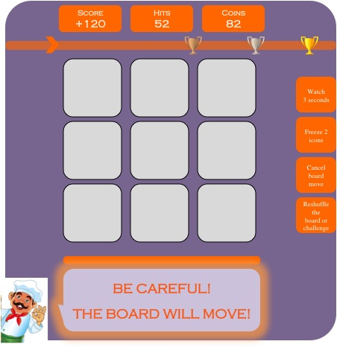
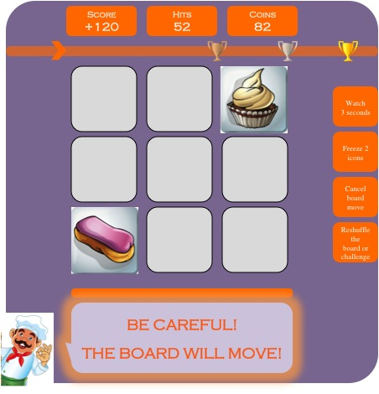
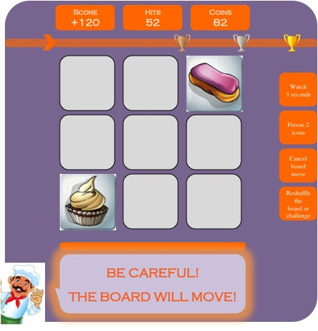
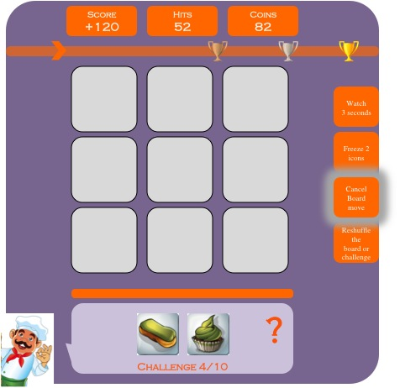
LEVEL 3 WITH END OF TUTORIAL
3.1/ The title of the game “POPCAKE LEGEND” appears with the baker + LEVEL 3 mention + objectives (see page 11)
3.2/ Score/hits/progress bar are reset. Number of coins is the remaining from Level2. BOARD is generated and the TIMER line starts decreasing. One last time, the RESHUFFLE ICON is flashing/highlighted to incentive players to click on it.
3.3/ The game continues as usual until Challenge 3. After completing Challenge 3 a flashing/highlighted message appears in the Challenge & Communication Zone: “BE CAREFUL! THE BOARD WILL MOVE!”
Lives
5
Lives
5
NO
YES
cust
cust
3.4/ As described in the excel spreadsheet Level 3 Challenge 4, then 2 icons appears and are switched together. The message stays visible.
3.5/ the 2 icons are switched visibly during a 3 seconds period
(please design a nice “move” from one place to the other).
The message stays visible.
3.6/ Icons are switched back. The message disappears and the Challenge 4 appears.
As a tutorial, the CANCEL BOARD MOVE icon is flashing to incentive player to click on it.
Lives
5
Lives
5
Lives
5
cust
cust
cust

Slide 8
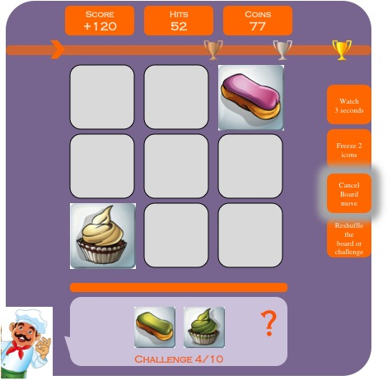
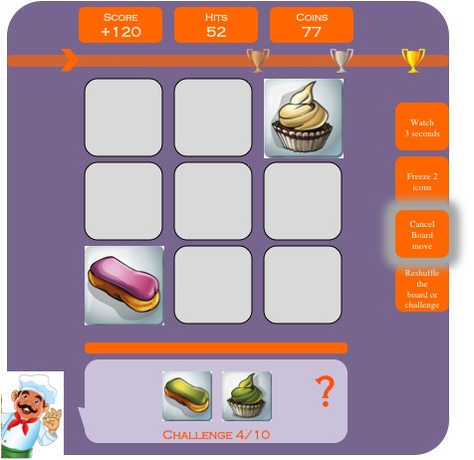
3.7/ If the player click on CANCEL BOARD MOVE, then coins are decreased by -5. The 2 moving icons reappears.
3.8/ Then the 2 icons are moving back to their original place. The 2 icons will then disappear. The whole move should take 3 seconds. The Challenge 4 stays the same.
3.9/ The game continues as usual until Challenge 6. At Challenge 7 the board will do a new move (please refer to excel).
Please apply the same exact methodology as previously described from step 3.3 to step 3.8
IMPORTANT NOTE:
THIS IS A TUTORIAL MODE WHERE THE PLAYER IS ONLY INCENTIVED TO CLICK ON THE FLASHING ICONS BUT NEVER FORCED TO DO SO. IF THE PLAYER DECIDES NOT TO CLICK THEN THE GAMEPLAY CONTINUES AS USUAL BUT THE BUTTON CONTINUES TO FLASH UNTIL CLICKED ON.
AS REAL MONEY WILL BE INVOLVED IN THE GAME, A CONFIRMATION BUTTON WITH PRICE MIGHT BE NEEDED FOR ALL 4 MONETIZATION BUTTONS. I WILL STUDY HOW TO INCORPORATE SMOOTHLY.
Lives
5
Lives
5
NO
YES
cust
cust

Slide 9
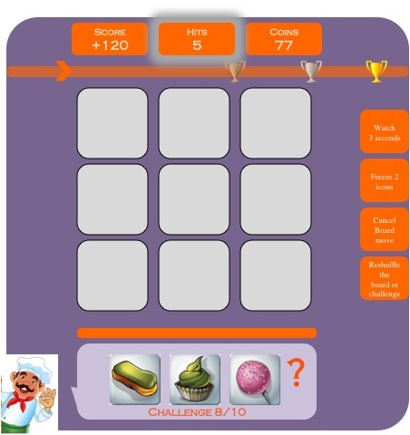
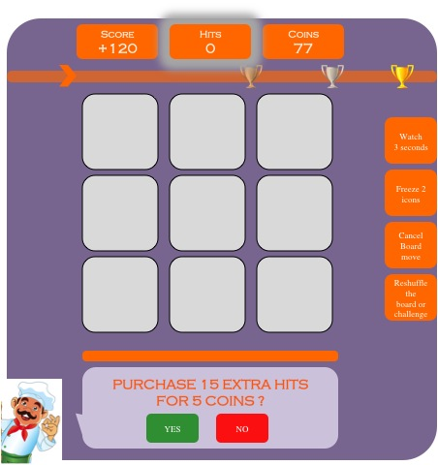


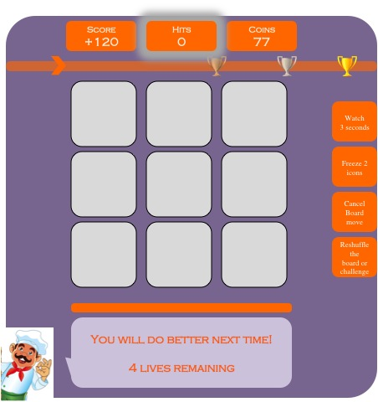
MONETIZATIONS BUTTONS + PURCHASE CONFIRMATION BUTTONS
IMPORTANT NOTE:
THIS SECTION APPLIES TO ALL LEVELS FOR:
Hit system
Lives system
Monetization buttons
THE GENERAL PRINCIPLE IS THAT FOR ANY PAYMENT WITH CHOCOLATE COINS THE PURCHASE SHOULD BE CONFIRMED BY CLICKING YES OR NO
HITS) On any level, When the number of HITS reach 5, then the counter starts flashing to warn the player
HITS) When HITS reach 0, a message + confirmation buttons appear in the COMMUNICATION ZONE. Costs 5 coins for 15 hits+15 seconds
Lives
5
Lives
5
cust
cust
HITS.c/ If the player purchases 15 extra hits, then he continues the game where it stopped with +15 hits and -5 coins
LIVES) If the player does not purchase hits, then he looses 1 life, cf communication zone + encouraging message. The game restarts at the BEGINNING of the Level where the player lost.
OTHERS) Each confirmation messages should be different, according to each monetization button.
RESHUFFLE THE BOARD
FOR 1 COIN ?
Lives
5
Lives
4
YES
NO
RESHUFFLE THE CHALLENGE
FOR 1 COIN ?
YES
NO
WATCH THE BOARD 3 SECONDS
FOR 3 COINS ?
YES
NO
CANCEL BOARD MOVE
FOR 5 COINS ?
YES
NO
cust
cust
FREEZE 2 ICONS DURING WHOLE LEVEL FOR 7 COINS ?
YES
NO

Slide 10
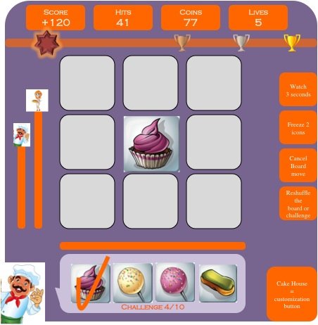
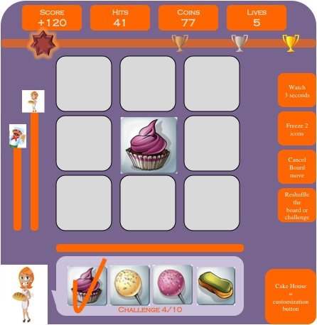
DUO VERSION ON THE SAME SCREEN
IMPORTANT NOTE:
TO MAKE THE CODING SIMPLE I HAVE KEPT ALL FUNCTIONS OF THE SOLO VERSION ACTIVE IN THE DUO VERSION:
ALL INDICATORS STAY THE SAME
ALL THE MONETIZATION BUTTONS STAY ACTIVE
THE SOLE DIFFERENCE IS THE PLAYER PROGRESS BAR ON THE LEFT WHICH SHOW THE NUMBER OF CHALLENGES THAT EACH PLAYER HAS WON
THE BAR MOVES UP BY 1 FOR EACH CHALLENGE WON.
AT THE END OF 10 CHALLENGES THE PLAYER WHO HAS WON THE MORE CHALLENGE IS THE WINNER
PLAYER 1: when its player 1 turn, then the MALE mascot appears
PLAYER 2: when its player 1 turn, then the FEMALE mascot appears

Slide 11
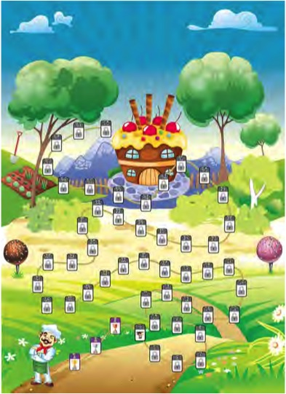
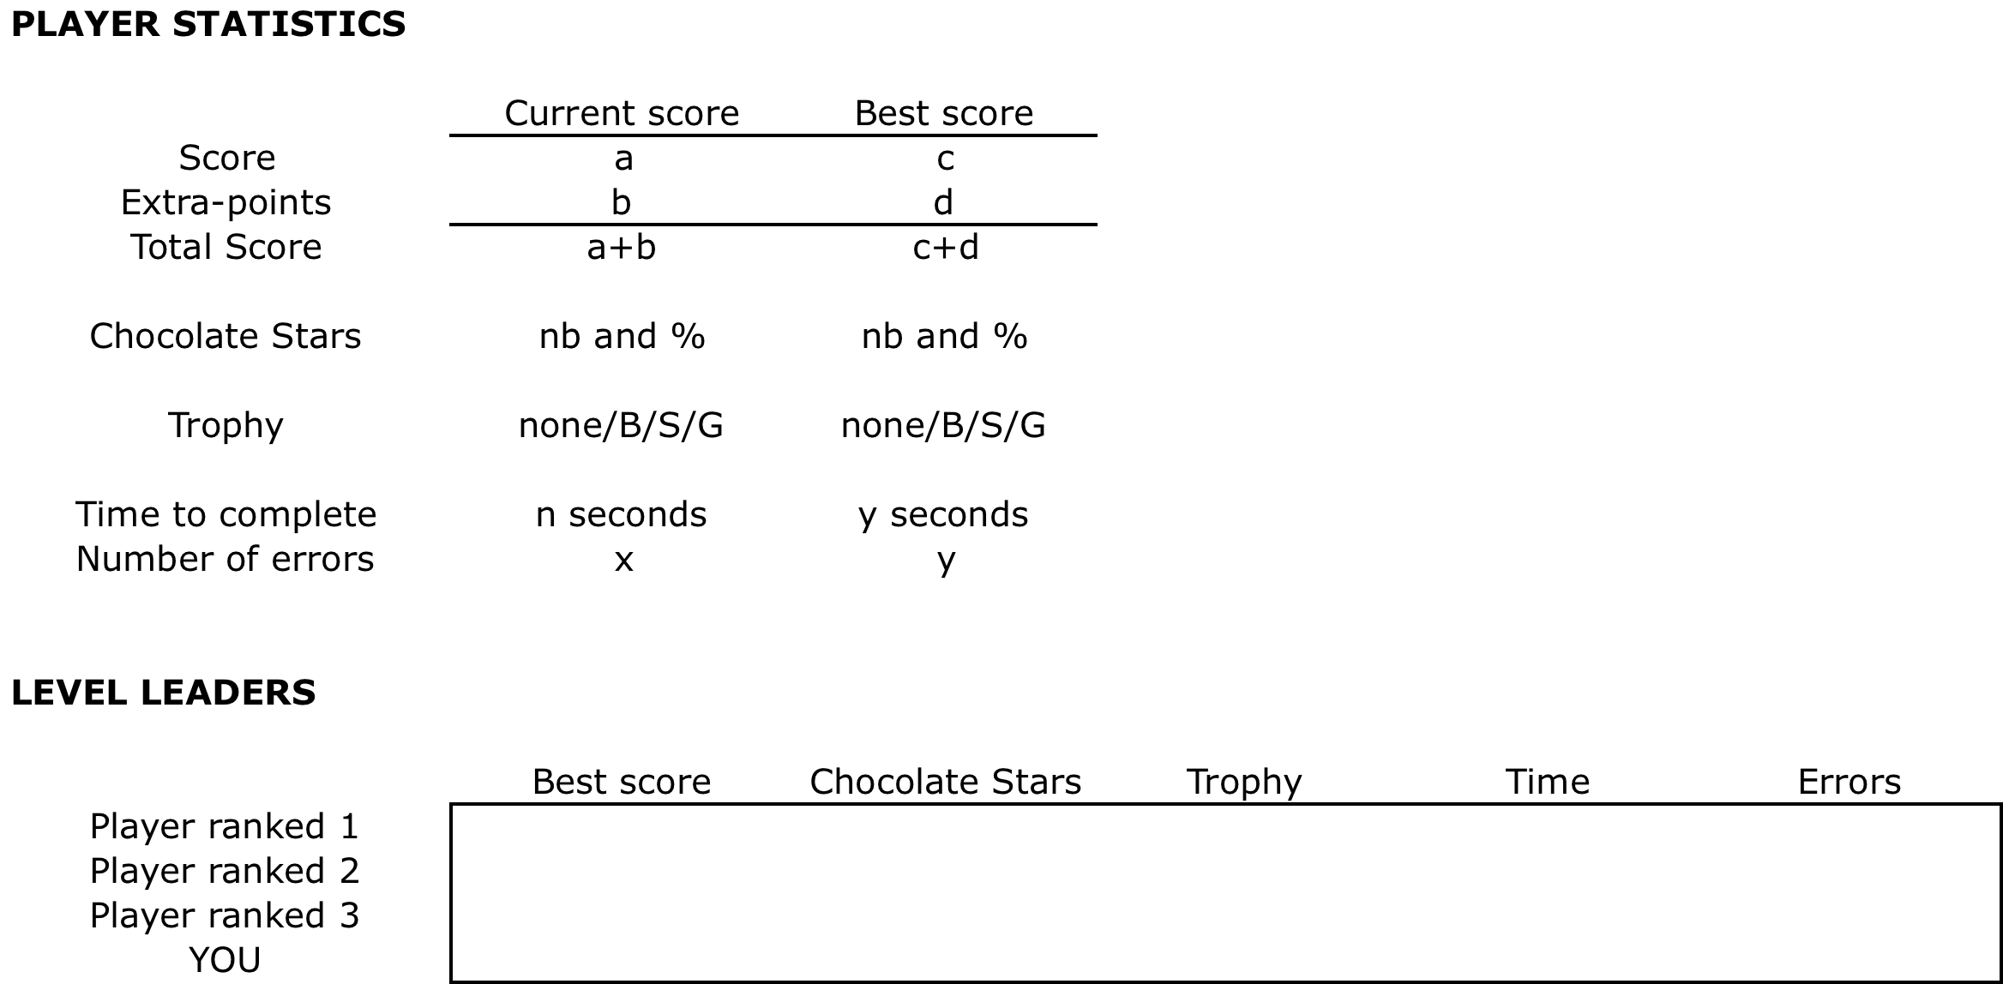
Intermediate screens: objectives & leaderboards
IMPORTANT NOTE:
INTERMEDIATE SCREENS WILL APPLY FOR EACH LEVEL IN THE FOLLOWING ORDER
THE PLAYER ACCESSES A SPECIFIC LEVEL BY CLICKING ON THE LEVEL MAP
A SCREEN WITH OBJECTIVES OF THE LEVEL APPEARS
THE GAME BEGINS: Challenges 1 to 10
A SCREEN WITH STATISTICS & LEADERBOARDS APPEARS
1/ PLAYER selects the Level on the map. The player may access and/or replay all unlocked levels
(SOLO or DUO versions)
2/ The title of the game “POPCAKE LEGEND” appears and the OBJECTIVES screen for the Level are written in white on a baker blackboard (slate). For instance:
“Today’s special: Complete 10 Challenges in 60 Hits and 180 seconds. Be careful, the board will move after Challenge 3 and 6. Bon appétit!”
3/ Once the Level is completed, a screen with statistics appears: the players stats are shown on the upper board (current score and best historical score) + the leaderboards stats are shown on the lower board

Slide 12

PLAYING SCREEN
Neutral
Icon
=
croissant
Score
+120
Hits
41
Coins
77
Lives
5
3 KEY INDICATORS
(Score / hits / coins)
PROGRESS BAR
(the arrow moves toward the trophies on the right, proportionate to the number of stars collected)
Watch
3 seconds
15 HITS
Freeze 2 icons
BOARD ZONE
With 9 icons
4 MONETIZATION BUTTONS
Cancel
Board
move
Neutral
Icon
=
croissant
Reshuffle the
board or challenge
Cake House
TIMER
(plain orange is decreasing towards left when seconds remaining decrease)
Challenge 4/10
MAIN MENU BUTTON
Designed as a baker mascot
Cake House
=
customization
button
15
SECONDS
TO MEMORIZE
NO
YES
CHALLENGE ZONE
With challenge numbering

